Slide 1

Quantitative Investment
An Exploration of Mean Reversion Strategy
Xinyi Wang, Xuandi Wang, Shiyu Jiang, Chungil Chae
Wenzhou-Kean University
December 20, 2020

Slide 2
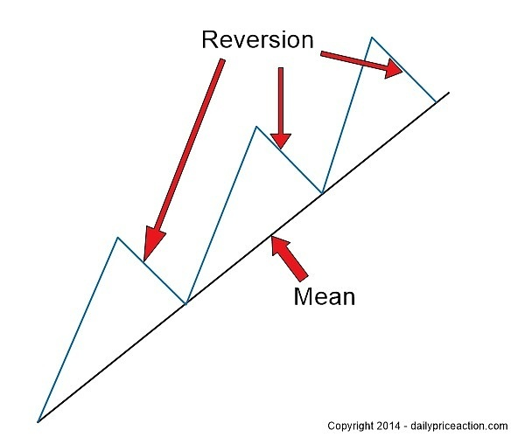
What is Mean Reversion?
Mean reversion is a theory used in finance that suggests that asset prices and historical returns eventually will revert to the long-run mean or average level of the entire dataset.
Source: Daily Price Action
Notes:
It is used as part of a statistical analysis of market conditions and can be part of an overall trading strategy. It applies well to the ideas of buying low and selling high, by hoping to identify abnormal activity that will, theoretically, revert to a normal pattern.

Slide 3
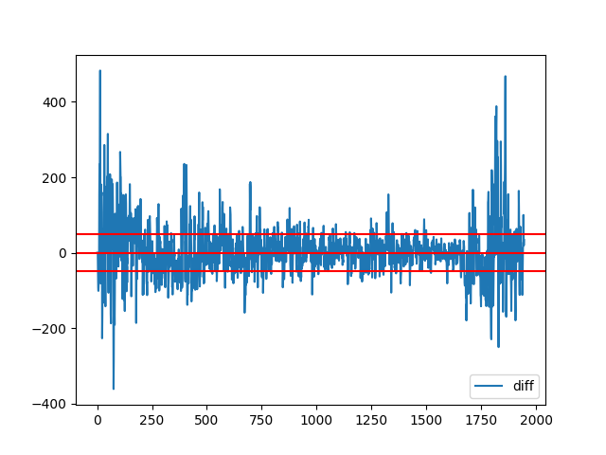
Difference between SMA and current price
Choices of threshold
1. SMA ± fixed value
2. SMA ± pct.SMA
3. Std ± pct.Std
Tips: simple moving average (SMA) calculates the average of a selected range of prices
Number of days
Notes:
A simple moving average is a technical indicator that can aid in determining if an asset price will continue or if it will reverse a bull or bear trend

Slide 4
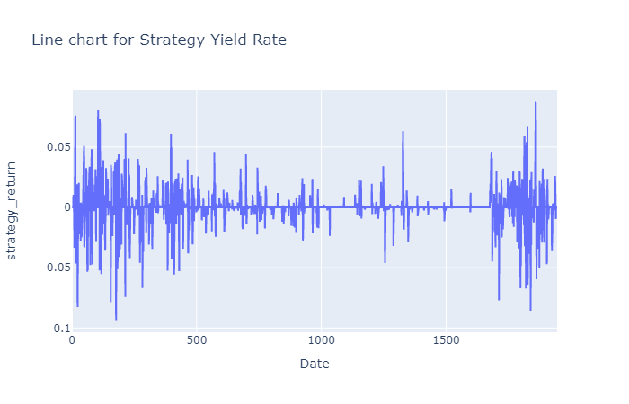
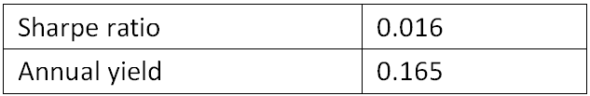
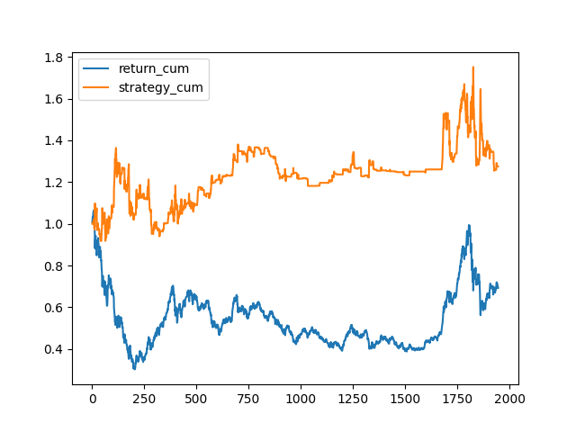
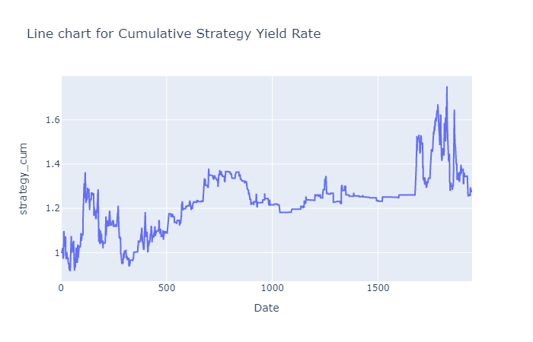
Scheme One
SMA ± fixed value: threshold = 50

Slide 5
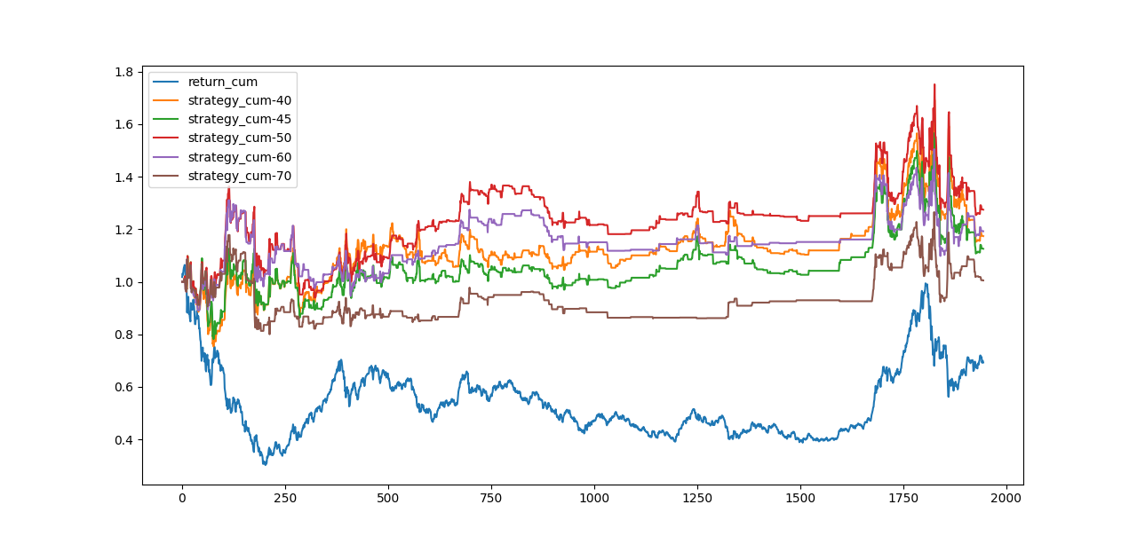

Slide 6
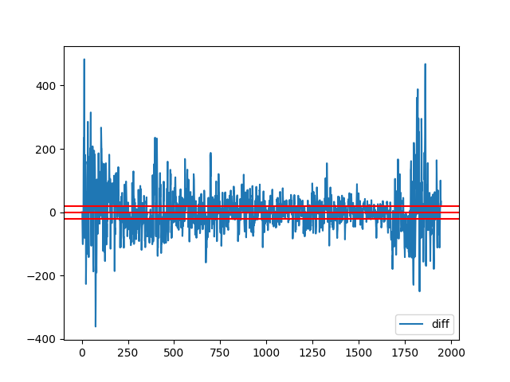
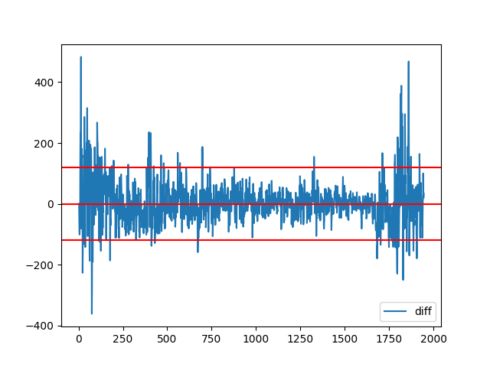
Key -- Find Best Tradeoff
Prob(Reversion) ↓
Prob(Open Position) ↑
Prob(Reversion) ↑
Prob(Open Position) ↓
Notes:
When the threshold is set too high, the stock may not be able to open the position, though the price will have high probability to reverse. When the threshold is set too low, it will lead to the decreasing probability of reversion, though the chance of opening position is increasing.
So in this case, the key the set the threshold is to find the best tradeoff.
This rule will also be applied in the next two strategies, and it appears in the form of adding percentage.

Slide 7
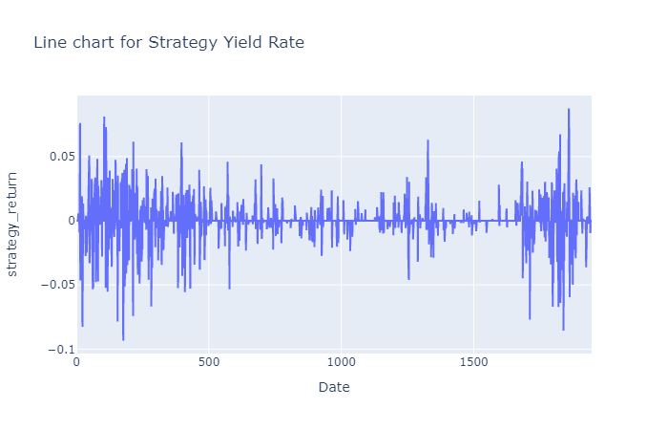

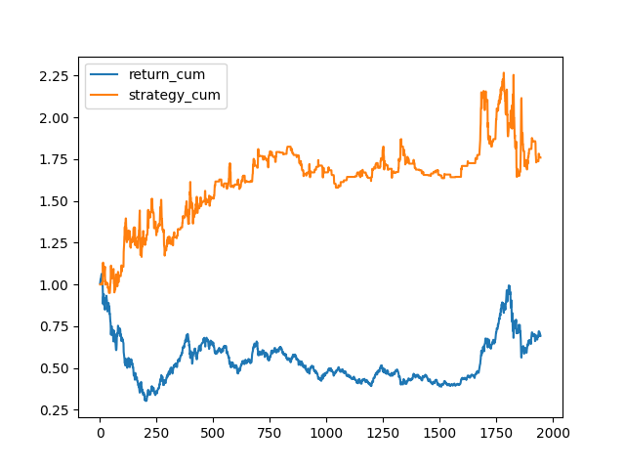
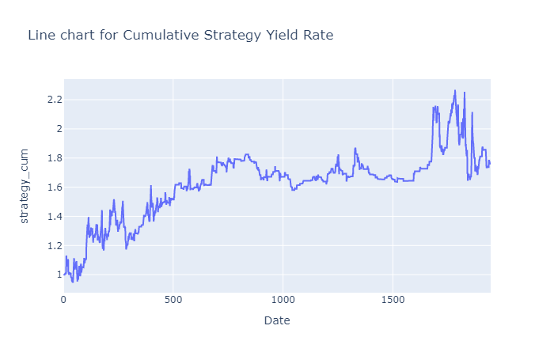
Scheme Two
5-days SMA ± (0.16 * 5-days SMA)

Slide 8
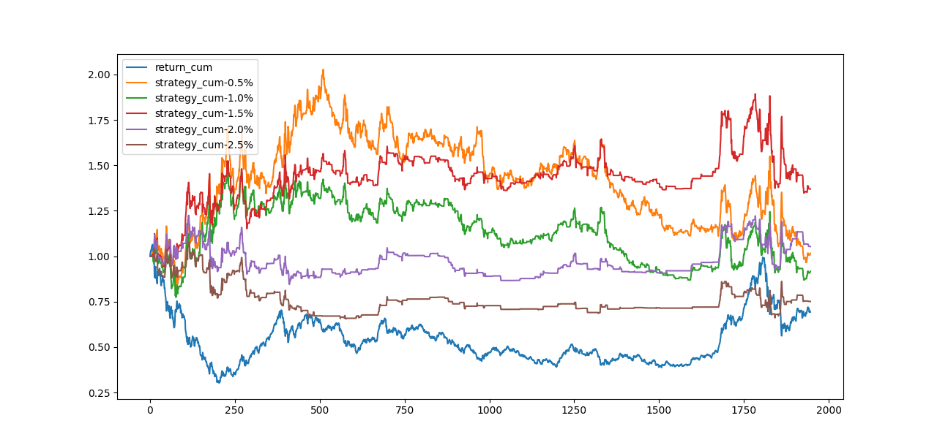
Notes:
It refer that different percentage adding will lead to different convergence of our threshold, so that we will get different results.

Slide 9
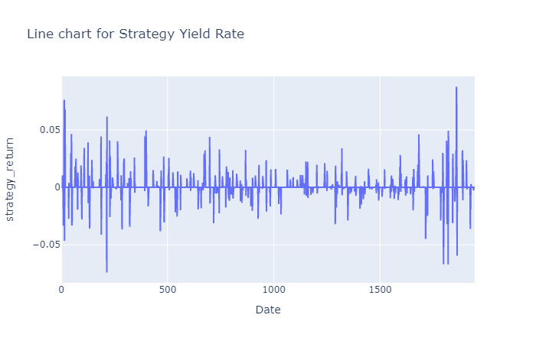

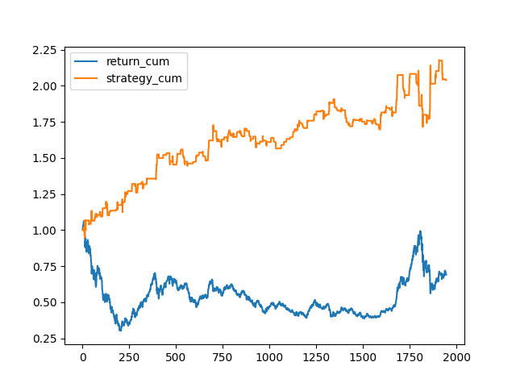
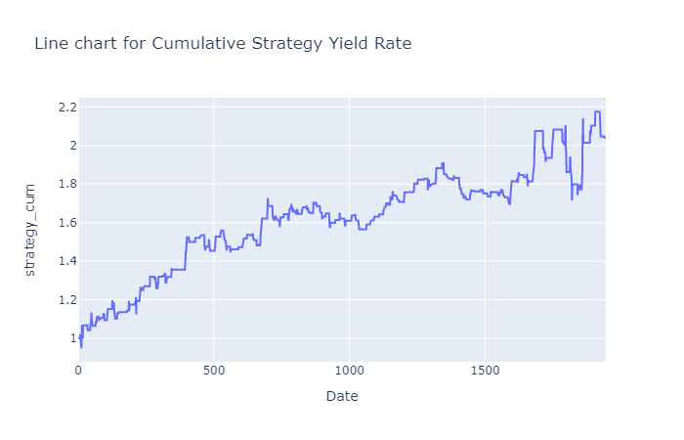
Scheme Three
17-days Std ± (0.07 * 17-days Std)

Slide 10
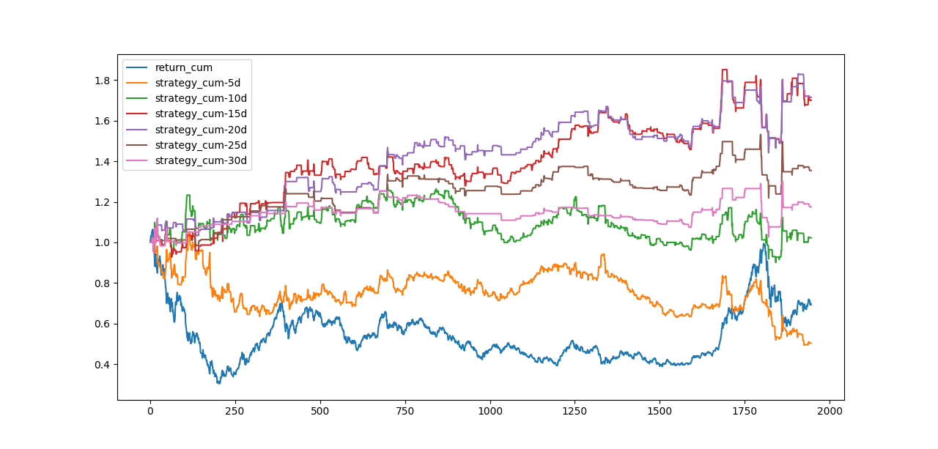

Slide 11
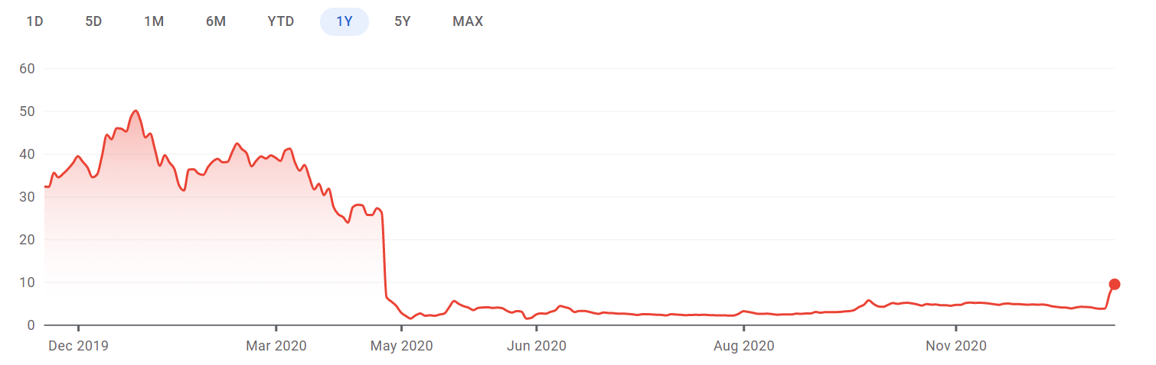
Example of Black Swan
Standard deviation should greatly reflect the fluctuation of the market
Source: Google Finance
Notes:
Then this specific example explains why 17days is a proper variance for this future. This is the Luckin Coffee Co. Stock we found on Google Finance. Around may in 2020, the price suddenly fall because of some unexpected incidents happened. But after a short while, the fluctuation just went normal. So if we shorten the days, we will not include the fluctuation related incidents, the standard deviation will not be accurate as what we want. Similarly, if we longer the days, the standard deviation will include the fluctuation information of some outdated incidents.

Slide 12
Horizontal Comparison
Standard deviation: A measure of the amount of variation of a set of values.
Notes:
Here we compare the effectiveness of three choices of thresholds. We get the expected results.
We have increasing results when we change the thresholds, so in first choice, we just use fixed threshold which is difficult to reflect the situation of fluctuation of the real market;
So we improve a little bit in the second method, we set the threshold with the percentage of the SMA, in this case, we can relate the volatility of the market to the threshold. Just like the figure we show here. The range will change according to the SMA.
As for the third strategy, we apply a threshold that more accurate show the dispersion degree of the market price, which is standard deviation. Same like the second one, we limit the range with percentage. In this case, better results appear.

Slide 13
Empirical Analysis
-- Hurst Exponent (Rescale Range Analysis)
Hurst Value is more than 0.5 (Trend following)
If the Hurst value is more than 0.5 then it would indicate a persistent time series (roughly translates to a trending market).
Hurst Value is less than 0.5 (Mean reversion)
If the Hurst Value is less than 0.5 then it can be considered as an anti-persistent time series (roughly translates to sideways market).
Hurst Value is 0.5 (Brownian Walk)
If the Hurst value is 0.5 then it would indicate a random walk or a market where prediction of future based on past data is not possible.
Source: Quantinsti
Notes:
Hurst exponent is an index used to measure whether time series have long-term memory. This index was originally proposed by Harold Edwin hurst, a British hydraulic scientist. He first proposed the index to study the time series of floods and droughts in the Nile to determine the optimal dam size, which was then used in the financial sector.

Slide 14
Calculation
Rescale range: Calculate n days’ market returns with values V1, V2, …, Vn;
HurstR: Calculate the range of the values (max-min);
HurstS: Gives the standard deviation of the values;
HurstRS: The range divided by the standard deviation;
For the whole sequence V1, V2, …, Vn, calculate a HurstRS value of the whole range, then do the same by splitting the sequence into two parts V1, V2, …, Vn/2 and Vn/2+1, Vn/2+2, …, Vn to calculate the HurstRS of the two ranges and average them. Then narrow partition iteratively until the range is small enough.
When getting all HurstRS values of different range scales, plot them on a log-log plot of the range sizes and their HurstRS values, then do a linear model fit to the data, so the slope of the line is the estimated Hurst exponent of the data.
Source: Wolfram Demonstration Project
Notes:
Let’s check the process of the calculation of Hurst exponent. There are several variables that we need to pay attention to: 四个指标
We keep narrow the partition and calculate all HurstRS values, then plot them on a log-log plot of the range sizes and their HurstRS values, after that fit the data with a linear model. The slope of the line is the result, which basically shows the pattern of the market and can predict the market to some extent.

Slide 15
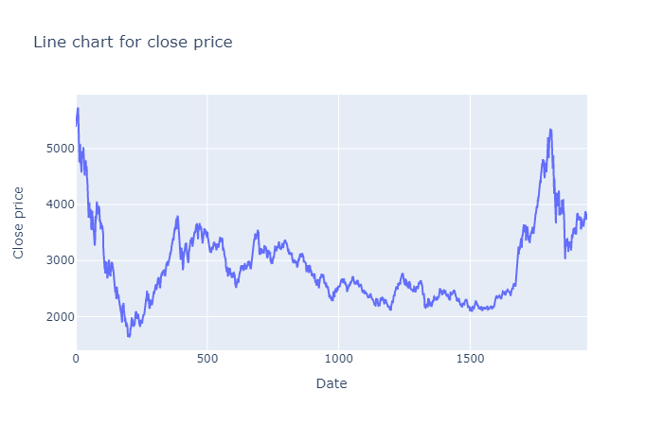
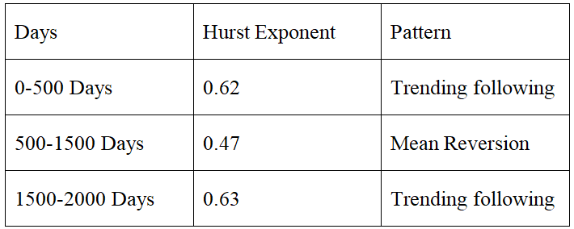
Testing Result
Notes:
先对hurst指数结果分析
In the following three graphs showing strategy yield rate, the two ends fluctuate and the middle is stable, so 500-1500 days is mean regression, while the other two intervals are trend following.
In this case, the testing result can exactly right fit our assumption, our strategy does better in the market with the pattern of mean reversion.

Slide 16
Reference Page
Divakar, V. Garg, A. (2018). The Hurst Exponent. Quantinsti. Retrieved from
https://blog.quantinsti.com/hurst-exponent/
Hurst exponent. (n.d.). Wikipedia. Retrieved from
https://en.wikipedia.org/wiki/Long-range_dependence
Hurst Exponent of Stock Price. (n.d.). Wolfram. Retrieved from
https://demonstrations.wolfram.com/HurstExponentOfStockPrice/#more
Luckin Coffee Inc - ADR. (n.d.). Google Finance. Retrieved from
https://www.google.com/finance/quote/LKNCY:OTCMKTS?sa=X&ved=2ahUKEwjUnIOI09nt
AhUq0FkKHQV7BvMQ3ecFMAB6BAgBEBk
Bennet, J. (2019). Mean Reversion: A Guide to Market Timing. Daily Action Price. Retrieved from
https://dailypriceaction.com/blog/mean-reversion-guide-to-market-timing/

Slide 17
Thank You!

